Slide 1



K00078544 – Ian Tully
Responsive News Site

Slide 2
Rationale
Personal interest.
Trust of consumer in reviews.
Combine topics of both music and technology.
Niche market.

Slide 3
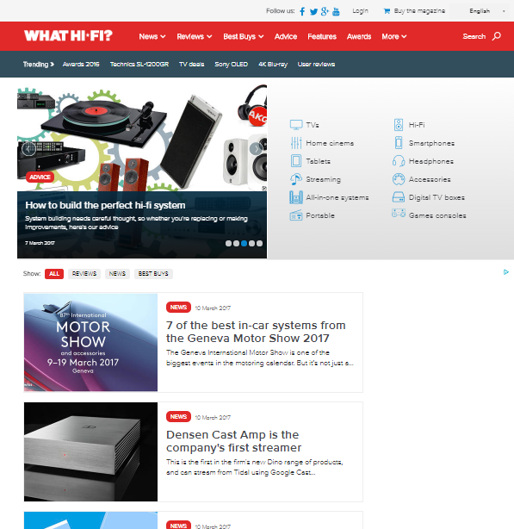
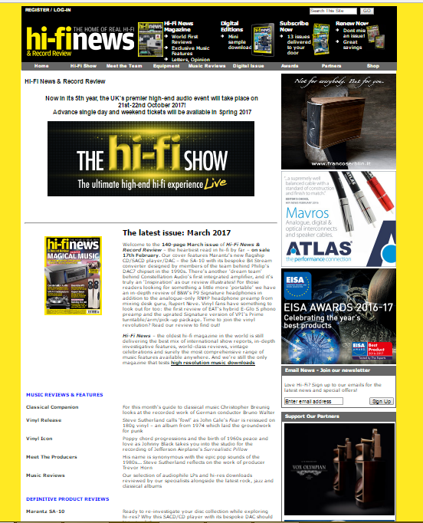
Research and Design Output

Slide 4

Research and Design Output
Cons
Non-Responsive
Hifi choice
Hifi News
Text & Content Heavy
Hifi news
Outdated Design
Hifi news
Pros
Music & Tech
Hifi News
Modern Design
What hifi

Slide 5

Research and Design Output

Slide 6
Research and Design Output
Design elements
Red hover to match logo text.
Red title colour for each section (highlight importance).
2/3 column display. (Adverts to right).
Spotify playlist on music review page (functionality)
Login register in right column.
Submit article in right column.

Slide 7
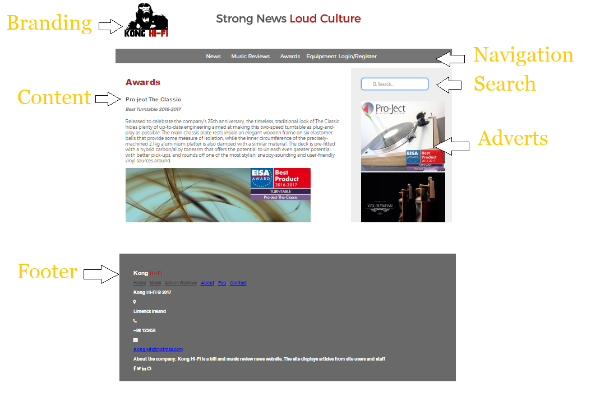
Website Structure

Slide 8
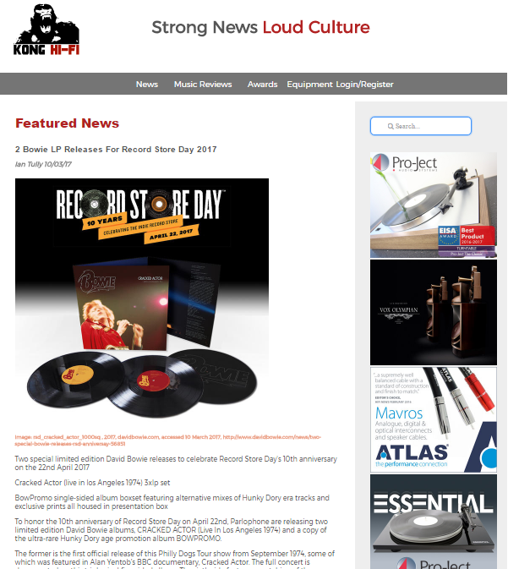
Home Page
Navigation
Featured Article
Latest News x 3 Read More
Album Reviews x 4 Read More
Awards Read More
Footer

Slide 9
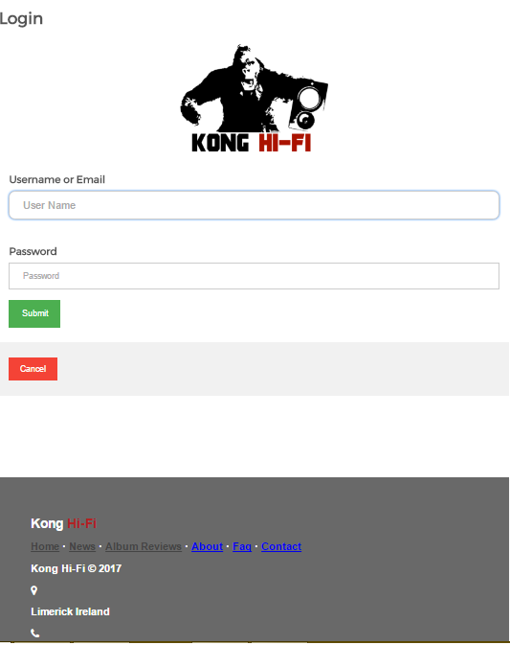
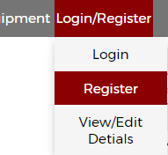
Login Register
View Edit Details
Dropdown on navigation
View/Edit Details to be hidden once database is synced.

Slide 10
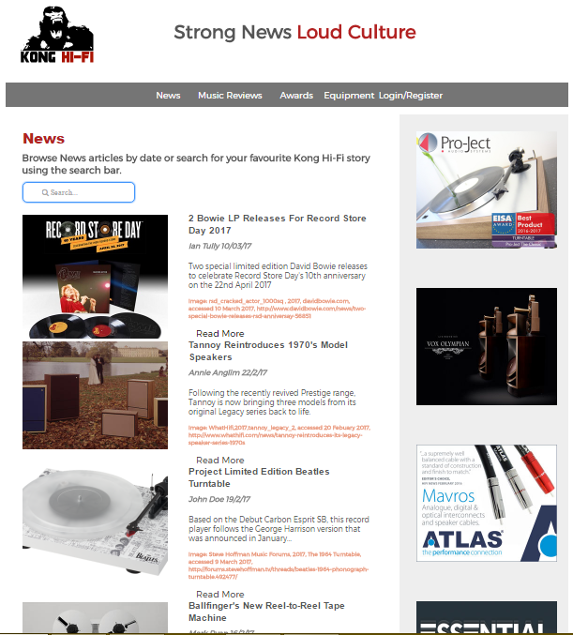
All News & Search Results
page
News in chronological order
Title, Summary, author, date & Smaller image.
Read more button link to full article.

Slide 11
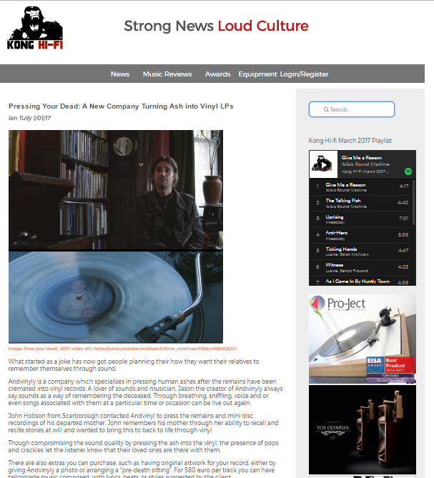
Full Article
Full news article with large image

Slide 12
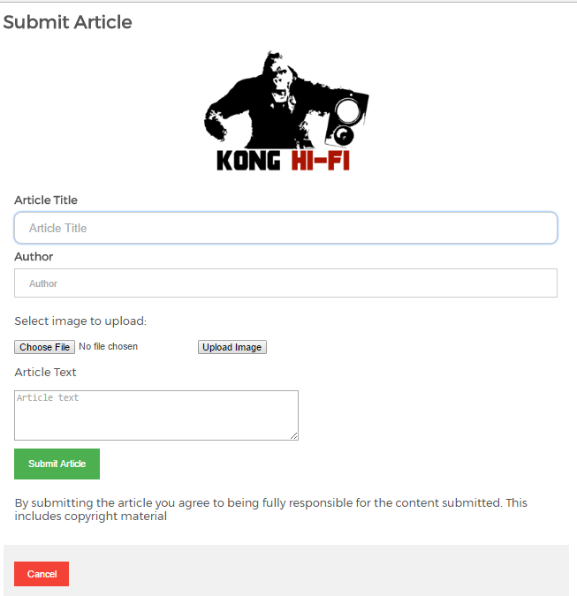

Submit Article
Article Title
Author
Upload image
Article Text
Submit
Cancel (home)

Slide 13
Responsive Design Dimensions:
@media screen and (max-width : 330px)
“ “ “ ” (max-width : 446px)
“ “ “ ” (max-width : 625px)
“ “ “ ” (max-width : 720px)
“ “ “ ” (max-width : 825px)
“ “ “ ” (max-width: 1000px)
“ “ “ ” (max-width: 1100px)

Slide 14
Problems and Solutions
Merge all news and search results page.
Album review images on home page positioning use of
article instead of a table to display images.
Overly complicated footer scrapped for more simple design.
Video resizing (div surrounding iframe relative, iframe absolute).
Git Hub – Lynda.

Slide 15
Demo
https://k00078544.github.io/KongHifi/index.html

